Slide 1


ECEN 403
Final Presentation
Team #25: The Only WGT Team Lead: Serene Singh
Joe Knipper, Salina Teng, Brayden Donovan
TA: Jianhan Pan
Sponsor: John Lusher

Slide 2
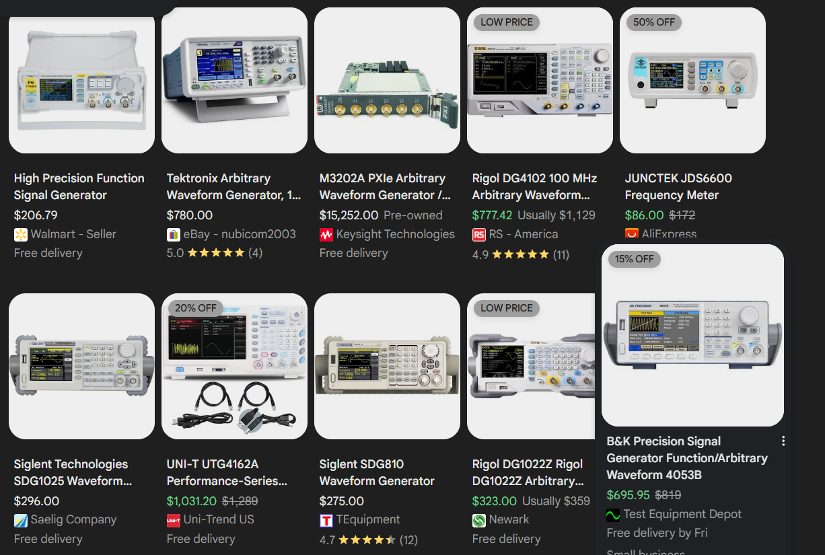
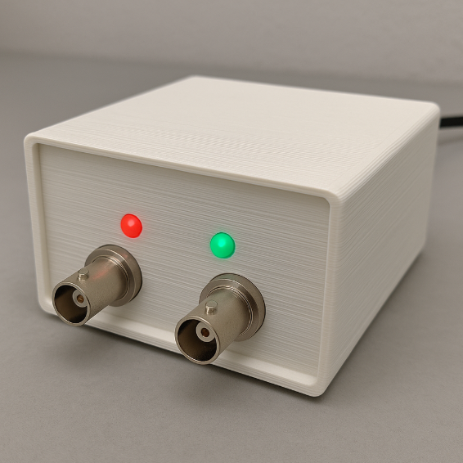
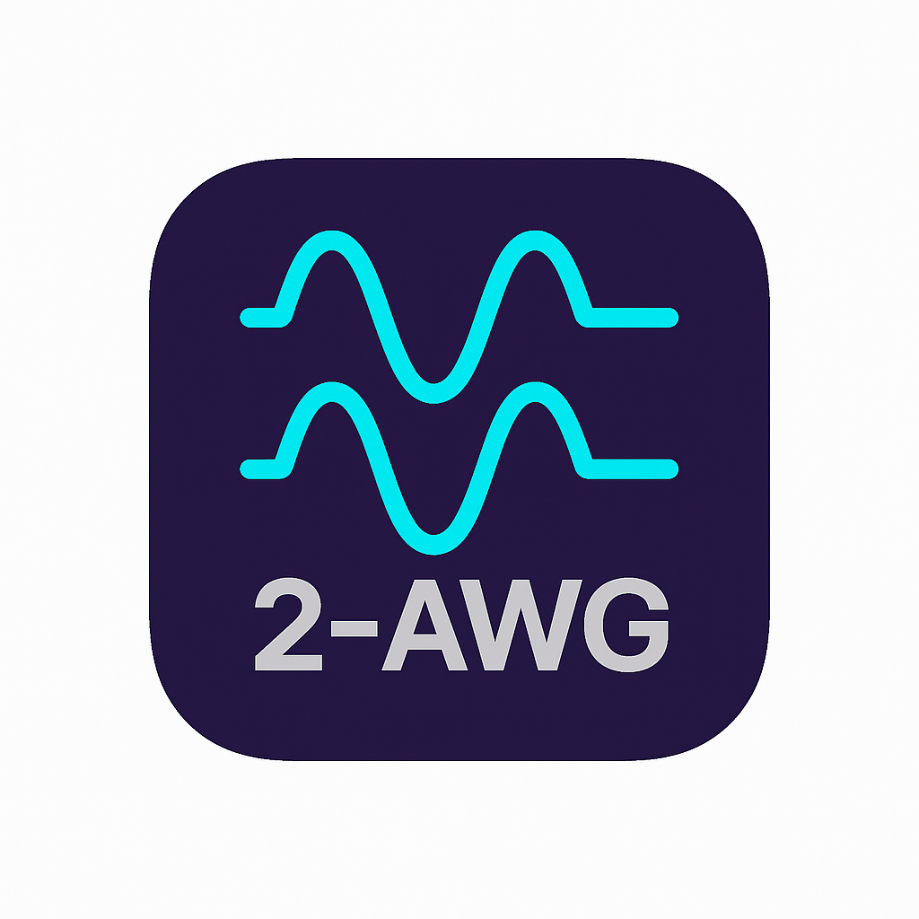
Project Summary
Problem Statement:
Traditional AWGs are bulky, confusing, and expensive
Average Price Range $200 to <$1000
Our Solution:
Compact, dual-channel Arbitrary Waveform Generator (AWG)
Controlled via mobile app with user-friendly UI
Outputs both standard (sine, square, triangle) and custom user-defined signals
Notes:
Good ENGINEERING figure here…eg plot showing the trend of the problem getting worse, figure showing a failed product, good logo for your product, …

Slide 3
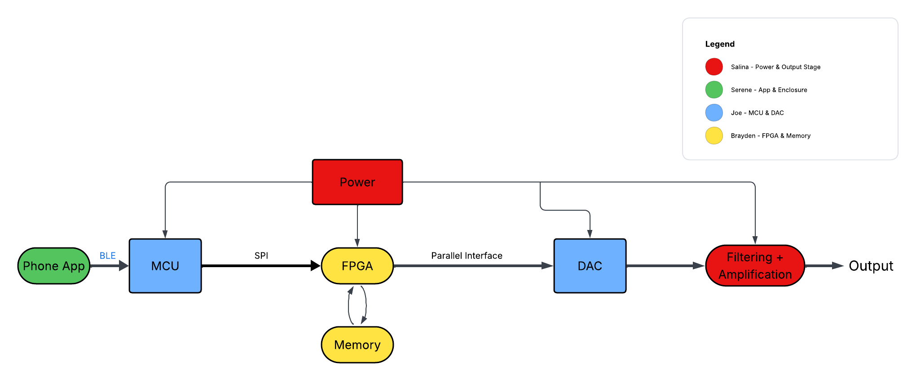
System Overview
Notes:
Cloud server and databaseThis figure should clearly show what HW & SW are being developed / integrated into each subsystem. Some interconnected boxes showing how subsystems will be connected for system.
Owner should be clear … name and color code
Interfaces – arrows between boxes, where known should be labeled…Bluetooth, I2C, Websocket
Push notifications, USB, LORA, …
NOT TOO MUCH DETAIL!

Slide 4
Mobile Subsystem
Serene Singh
Design
Test
Validate
Design a user friendly cross-platform app for AWG
Successfully Test BLE connection stability and packet transfer
Quantitatively verify successful tests
Established BLE Connection with MCU
Developed Front-End UI
Preset, Drawable, and Arbitrary adjustable screens with local waveform simulation
Included waveform editing, uploading, and downloading
Verified standard waveform parameters send to MCU accurately
Verified arbitrary waveform packets send to MCU accurately
Stress and Repeatability Testing ensured consistent results
App → MCU Communication connection strong and consistent within operational range
Ability to send numeric values, preset parameters, and Arbitrary waveform packages
Logging and Response confirmation from MCU
Notes:
Overview of what has been designed, tested, and validated for each subsystem for the project. (this is NOT a progress update, but rather a summary of what you have accomplished in 403).

Slide 5
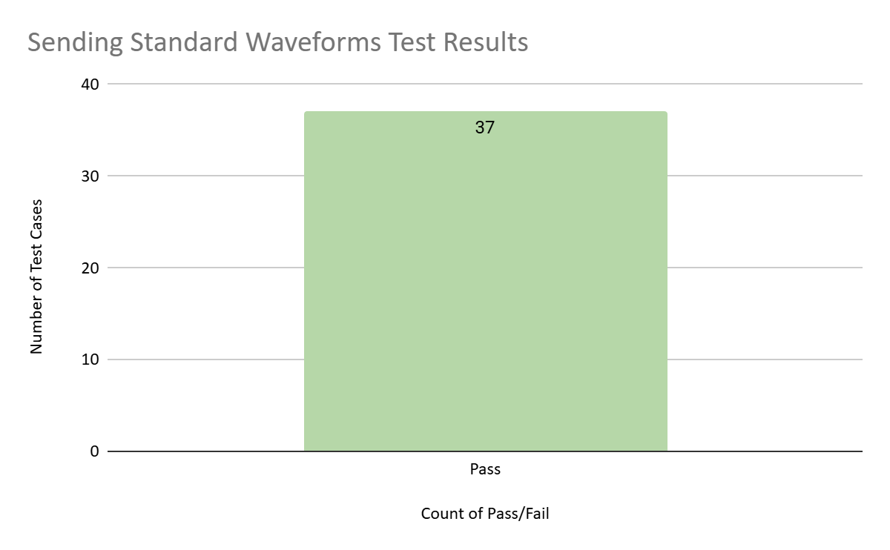
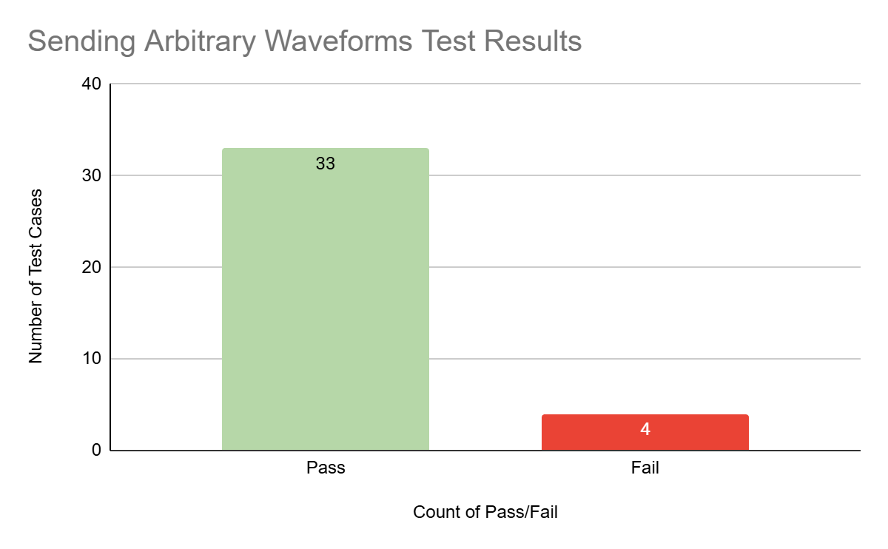
Verifying Standard/Arbitrary Parameters
All Tests Passed! 44/44
Some Tests Failed! 34/38
User Input Boundaries Need to be Implemented
Notes:
Show data collected and measured and/or simulated results (2 slides per subsystem)
Try to avoid screens of code
Save demo material for your project demo (video captures, storyboards, bench test pictures, etc.)

Slide 6
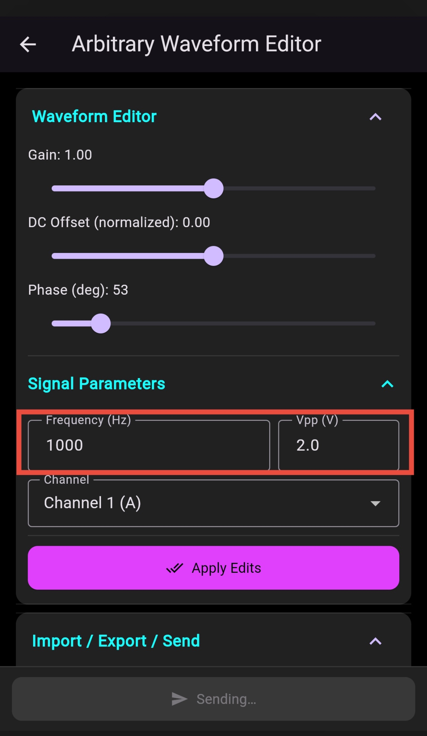
Remaining Tasks
Remaining in 403:
Add User Input Boundaries
To Complete in 404
Fully Integrate with MCU Subsystem
Finalize Enclosure
CAD Design
Print
Assemble

Slide 7
MCU Subsystem
Joe Knipper
Design
Test
Validate
Design a reliable embedded control subsystem for the AWG
Successfully Test BLE connection, LUT generation, and SPI stream
Quantitatively verify successful tests
Designed a custom ESP32-S3 MCU PCB
Implemented BLE firmware for receiving waveform parameters
Developed firmware to generate 64k-sample LUTs and stream them to the FPGA over SPI
Verified BLE connection is stable and robust
Verified 64k LUT generation is accurate
Verified SPI stream is accurate
MCU PCB BLE stable for 3+ hours
64K LUT waveform recreation 100% accurate
SPI stream validated using known parameters. 99.9% accurate
Notes:
Overview of what has been designed, tested, and validated for each subsystem for the project. (this is NOT a progress update, but rather a summary of what you have accomplished in 403).

Slide 8
Validation Plan
MCU Bluetooth Communication | Completed | 10/1/2025 | MCU Bluetooth communication established
MCU Receives & Decodes Parameters | Completed | 10/16/2025 | MCU correctly receives packets and decodes all fields (freq, amp, offset, phase, waveform) with 99.9% accurary.
LUT Computation | Completed | 10/16/2025 | MCU LUT development.
LUT Verification | Completed | 10/23/2025 | MCU correctly computes LUT from waveform parameters with 99.9% accuracy
DAC Static Output Test | Completed | 11/2/2025 | Write fixed codes (0x0000, 0x8000, 0xFFFF) to DAC. Output is within plus or minus 1% of expected output
MCU LUT Streaming SPI | Completed | 11/9/2025 | MCU streams LUT to logic analyzer via SPI correctly with 99.9% accuracry
End-to-End Subsystem Demo ready | Completed | 11/30/2025 | Full chain demo: Packet sent → MCU decodes & streams LUT. DAC outputs correctly

Slide 9
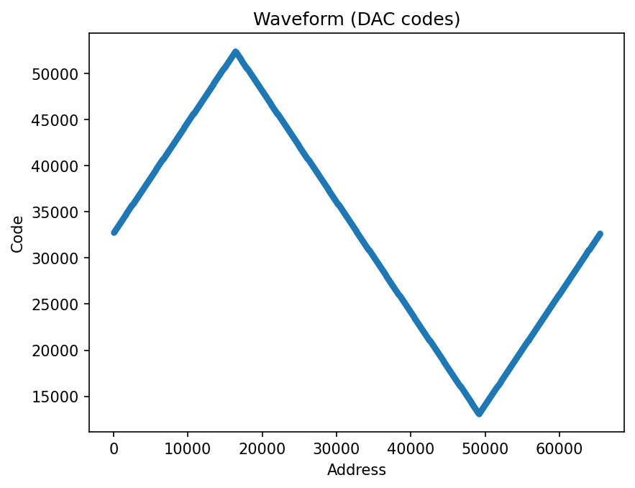
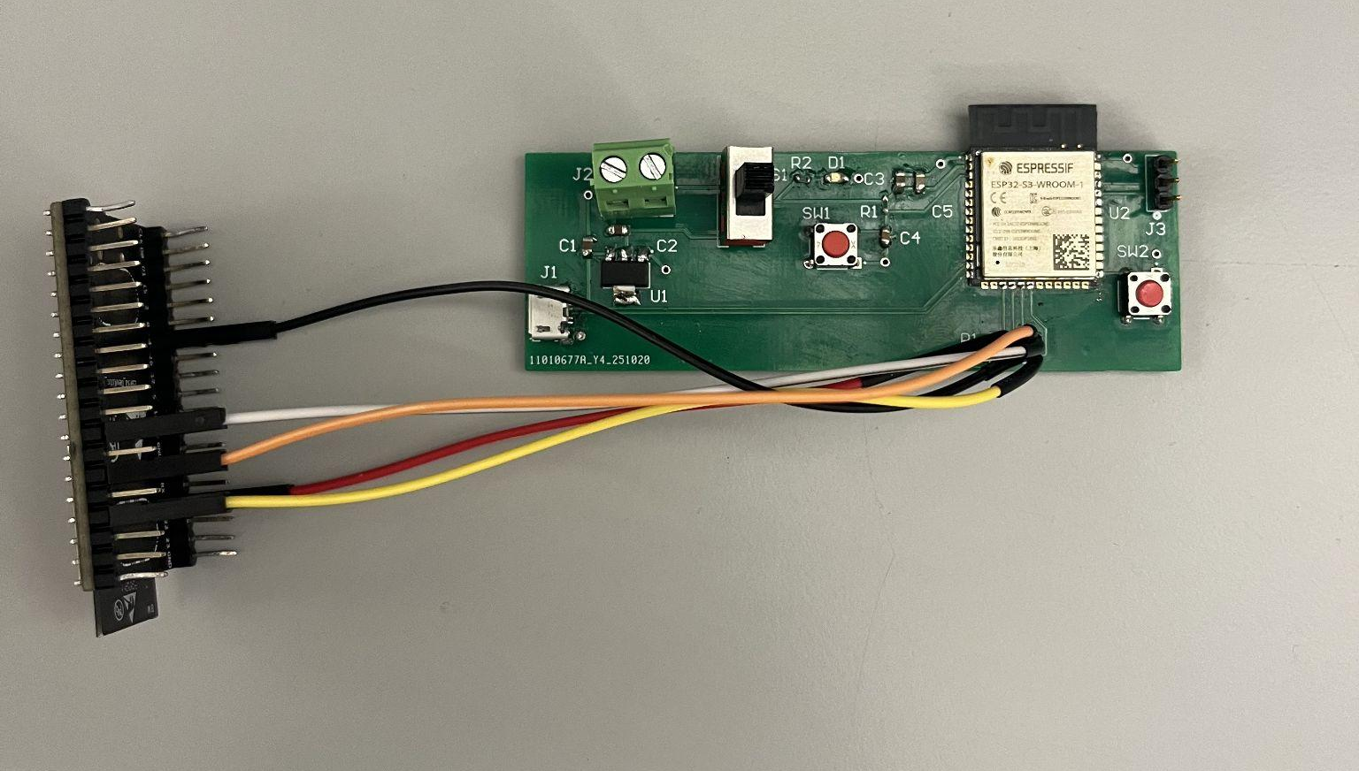
MCU Design Accomplishments

Slide 10
Remaining Tasks
Remaining in 403:
Bulletproof the SPI transmission
To Complete in 404
Integration with other subsystems

Slide 11
FPGA Subsystem
Brayden Donovan
Design
Test
Validate
Store and retrieve data from MCU at variable speeds
Successfully Test JTAG programming, SPI configuration, and data storage
Verify data accuracy
Designed, ordered, and assembled custom FPGA PCB
Developed HDL code for FPGA
SPI Decoder
Binary Counter
NCO
SRAM controller logic
Developed test benches for all HDL modules
Developed C++ code for ESP32 to generate SPI test input
Used test benches to verify all HDL modules were working as intended in simulation
Was able to successfully program FPGA flash memory with JTAG
Used test SPI input to change operating mode of FPGA
Tests were validated by connecting to a digital logic analyzer
LEDs were used to visually confirm the mode of operation of the FPGA
Notes:
Overview of what has been designed, tested, and validated for each subsystem for the project. (this is NOT a progress update, but rather a summary of what you have accomplished in 403).

Slide 12
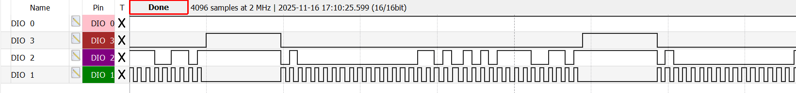
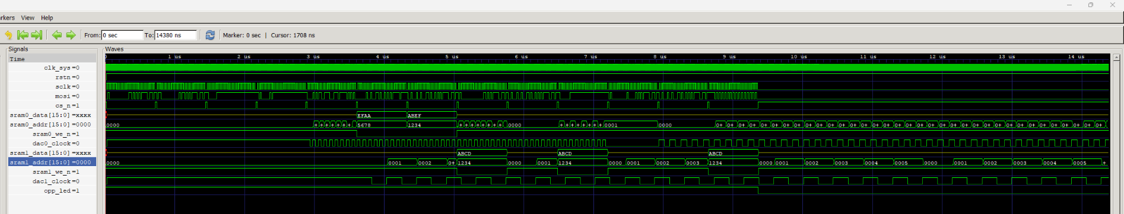
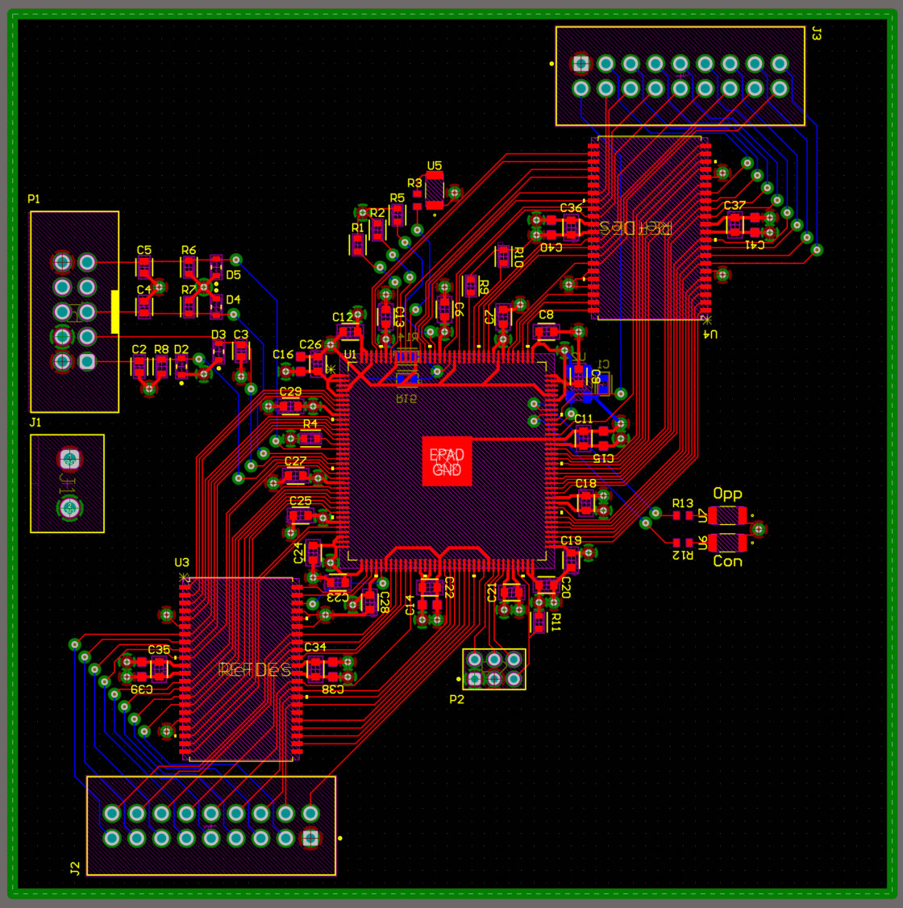
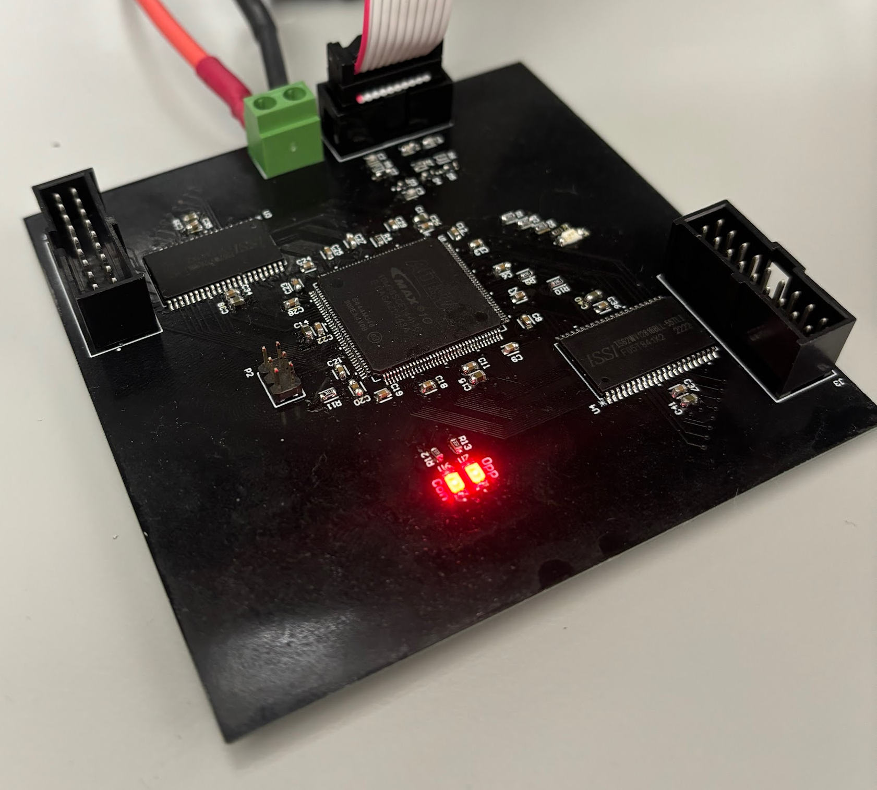
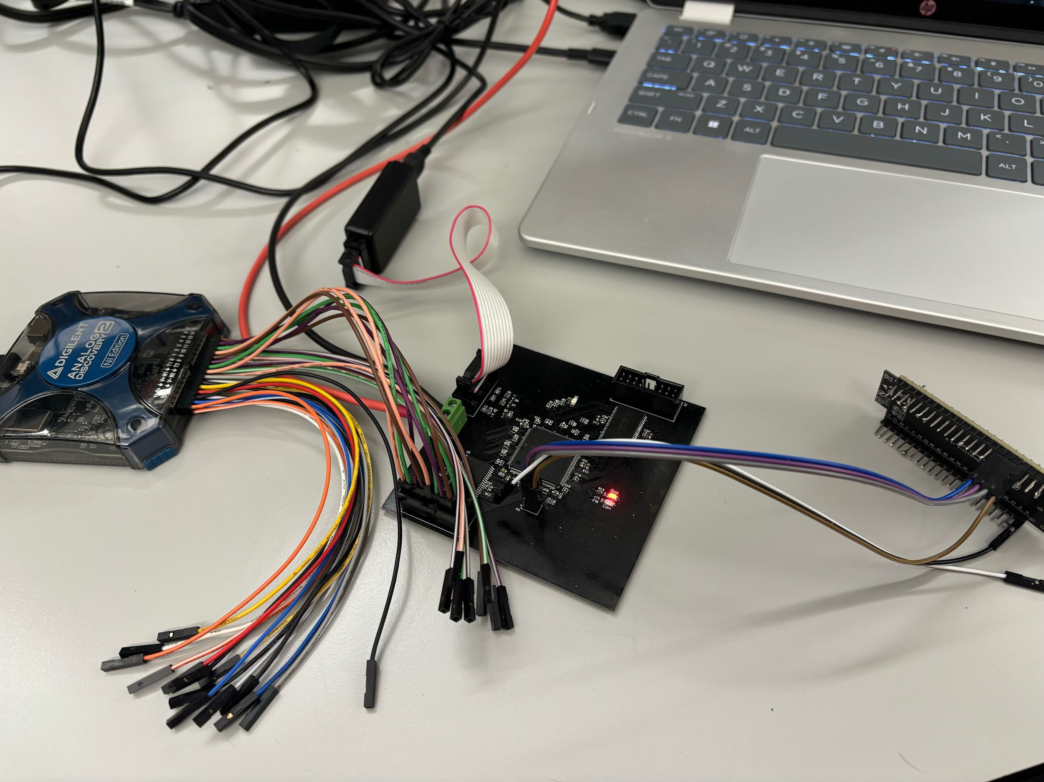

Slide 13
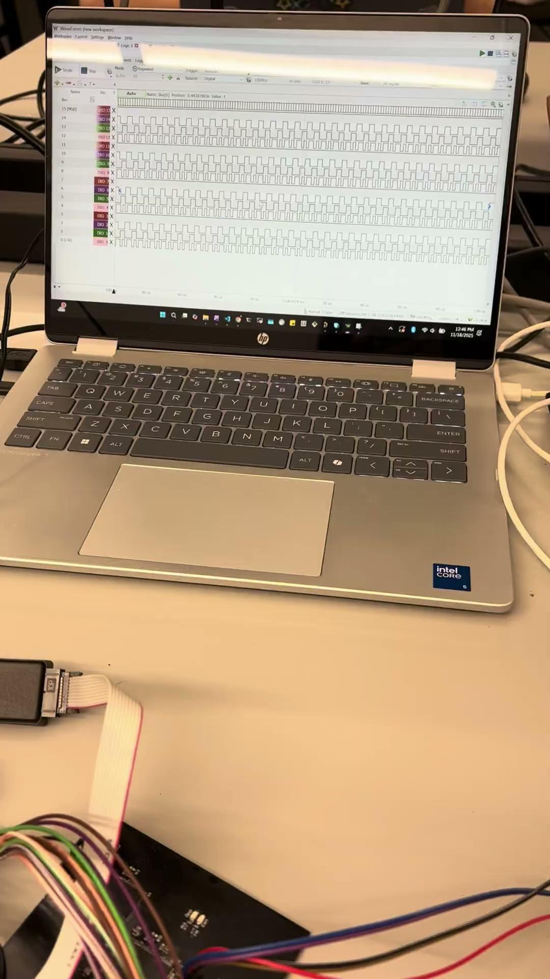

Slide 14
Remaining Tasks
Remaining in 403:
Further testing on FPGA
To Complete in 404
Integration testing with other subsystems

Slide 15
Power Subsystem
Salina Teng
Design
Test
Validate
Create a stable, low-noise multi-rail power design for the AWG
Verify converter startup behavior, rail stability, and load performance
Quantitatively confirm rail accuracy, noise, and reliability
Defined +12V → ±10V, +5V, +3.3V, +3.3V_CLEAN rails on schematic/PCB
Added input protection & filters
Selected the proper DC/DC converters for all rails
Added precision VREF IC for clean DAC reference
Simulated transient/steady-state rail performance in LTspice
Measured rail voltage and startup behavior
Performed load-step and Vin-step tests on all rails
Confirmed voltage rail accuracy (±2% tolerance) and load regulation
Voltage rails remain stable for over 15 minutes of usage
Notes:
“For the power system, I designed all the rails from the main +12V input, including ±10V, +5V, +3.3V, and a low-noise 3.3V rail. I added input protection, filters such as the pi filter, and selected the appropriate DC/DC converters for the different subsystems and a precision VREF IC for a clean DAC reference. I simulated transient and steady-state behavior in LTspice, then measured startup, and overall validated their performance across the full +-10% input voltage range and varying the load . All rails held accurate voltage within +-2% tolerance and stayed stable for over 15 minutes”

Slide 16
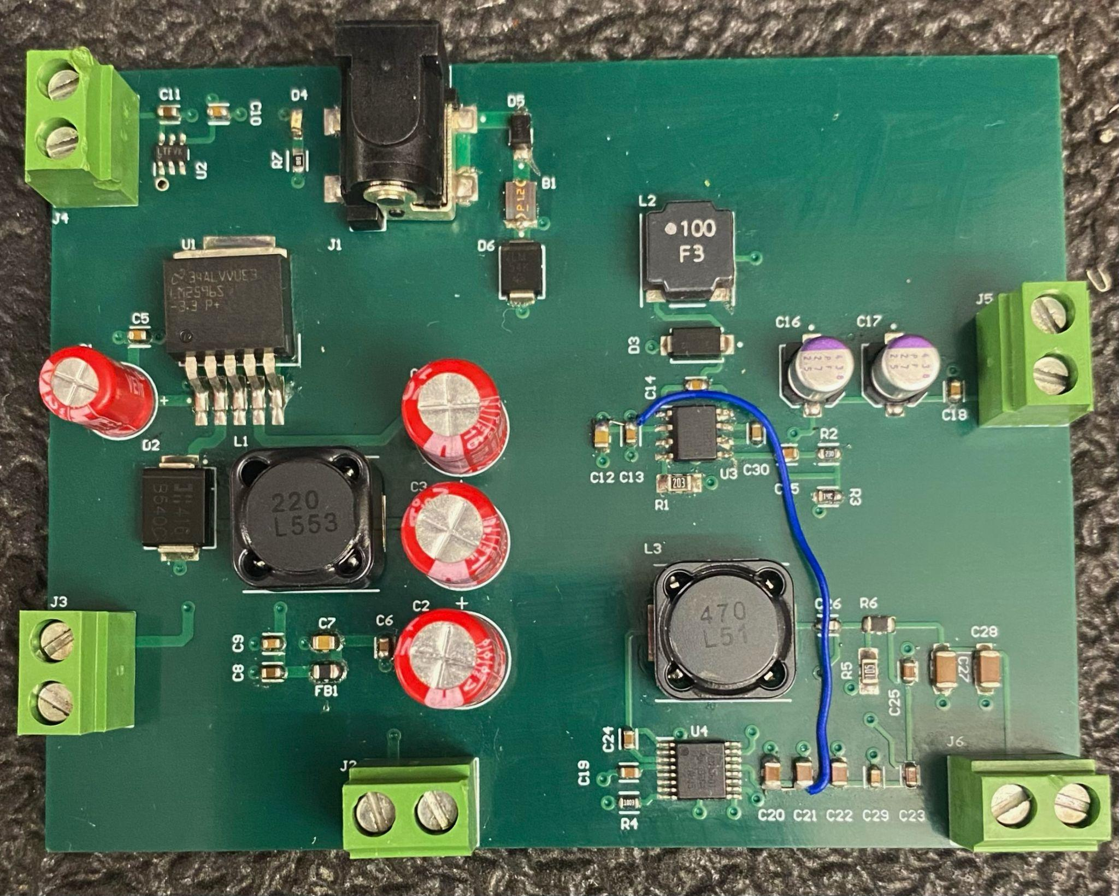
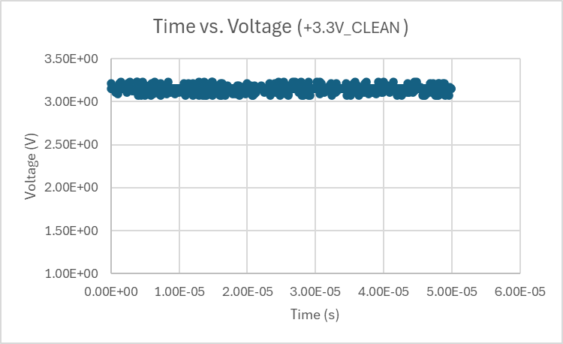
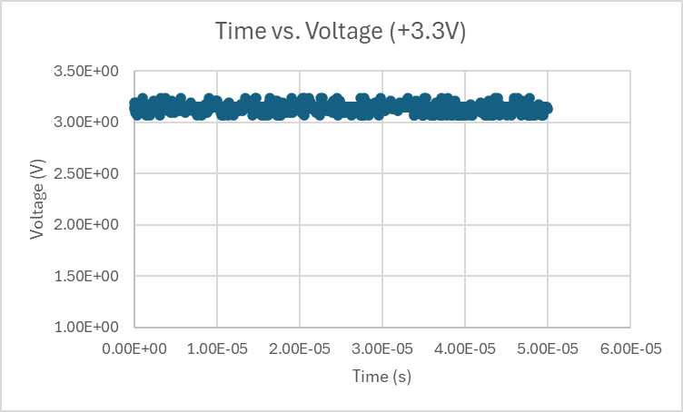
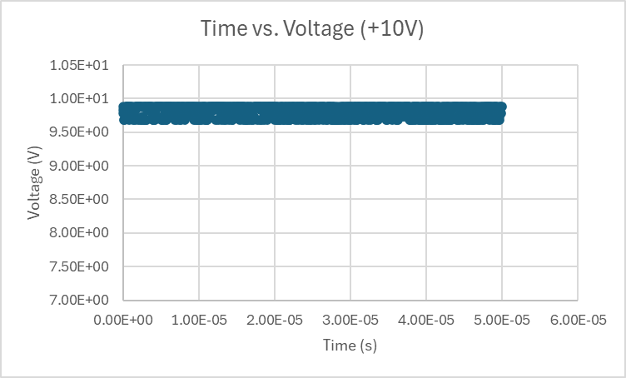
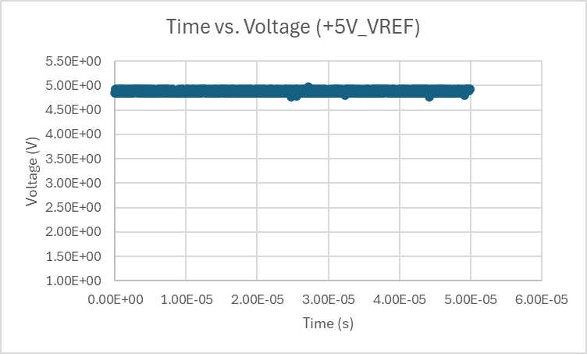
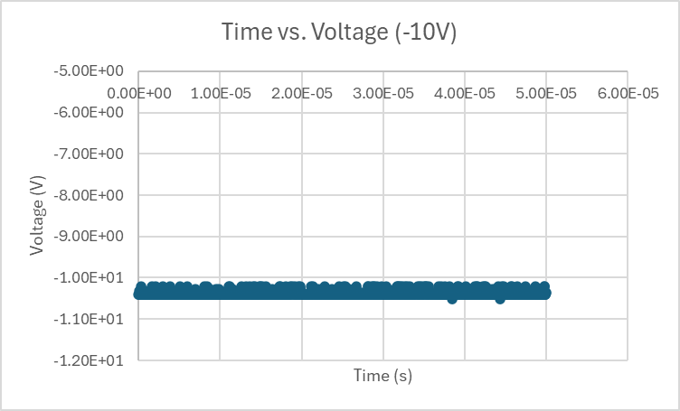
Power Design Accomplishments
Notes:
These plots are collected from the voltage rail testings. The top two plots displays the voltage readings for the +3.3V and filtered +3.3V over a period of time, and it can be seen that the rail remains stable around the +3.15V to +3.20V range.Similarly, the +10V rail is stable and lies around the +9.9V, the +5V is stable within the +4.9V range, and the -10V is also stable within the -10.4V range.
It should be noted that these data were collected using the oscilloscope, causing the DC voltage accuracy to be slightly lowered due to the oscilloscope’s input impedance. When I measured the rails with a digital multimeter, the rails measures within the +-2% tolerance. For instance, the +3.3V rail actually reads +3.26V using the multimeter, and the +10V actually reads +10.01V.
On the upper right is my power PCB. The upper left terminal is my +5V output, moving counter clockwise, next is the filtered +3.3V, then the regular +3.3V, then the -10V, and lastly the +10V.

Slide 17
Remaining Tasks
Remaining in 403:
Verify each rail operates stably for 30 minutes under full load
To Complete in 404
Confirm rails meet maximum load current requirements
Validate rails reliably power all subsystems
(DAC, MCU, Memory, FPGA, Analog Output Stage)
Notes:
The remaining task for 403 involves further testing the power board, which involves testing the board can remain stable for over 30 minutes under full load based on each subsystem’s max current draw .
In 404, I aim to confirm that all rails can deliver their maximum expected current and reliably power every subsystem without voltage drop or instability.

Slide 18
DAC/Output Filter Subsystem
Salina Teng
Design
Test
Validate
Create a clean ±5V, 100 kHz analog output path for the AWG
Verify analog signal integrity and stage-to-stage performance
Confirm final output meets AWG performance requirements
Defined DAC → I/V Converter → Low-pass →
Unity Gain Buffer design on schematic/PCB
Ensured ±10V rails support ±5V swing into 50 Ω at 100 kHz
Selected proper op-amps and passive component values to meet design specifications
Measured DAC → I/V Converter voltage value accuracy
Confirmed low-pass cutoff (150 kHz) and attenuation
Tested unity gain buffer output swing and load drive (50 Ω)
Verified full-chain output: ±5V, 50 Ω
Ensured stable operation on ±10V rails with minimal distortions
Successfully generated ±5V sine, sinc, and DC pulsing waves
Notes:
“For the analog output stage, I implemented a I/V converter → low-pass filter → unity-gain buffer chain coming from the DAC. I designed the stage to drive ±5V into 50 Ω at 100 kHz using ±10V rails and selected op-amps and passives to hit the 150 kHz cutoff for the low pass filter, along with other design requirements. I tested the I/V accuracy, filter response, and output swing under the 50 Ω load. The full chain produced clean ±5V sine, sinc, and square waves with stable operation and minimal distortion, and this also confirmed that the DAC is working properly by producing the correct current based on the inputted 16-bit digital code.”

Slide 19
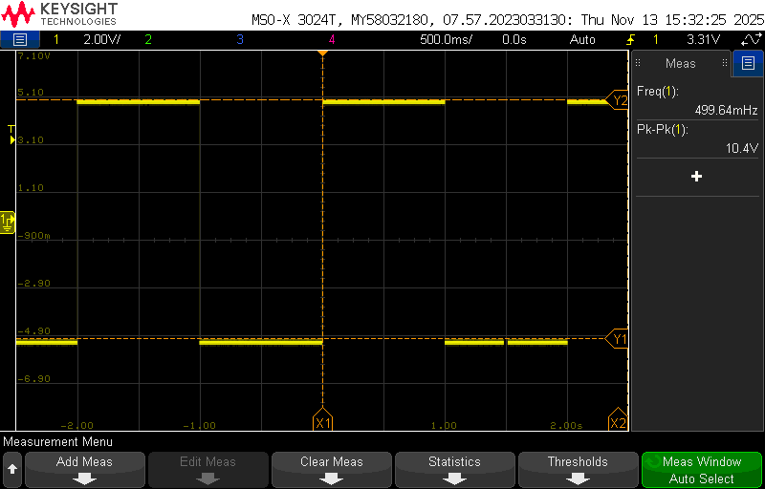
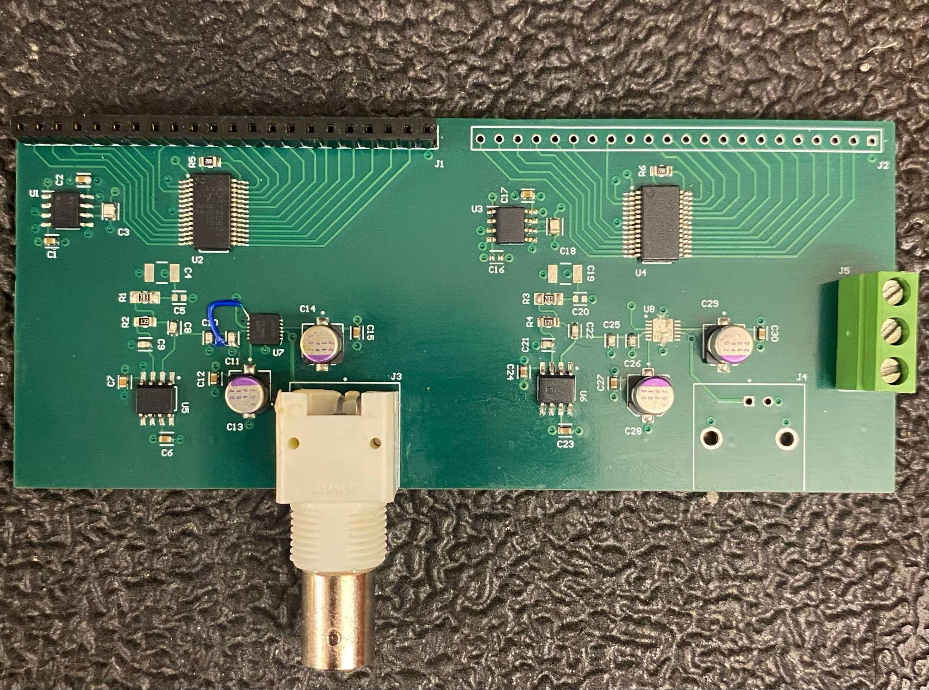
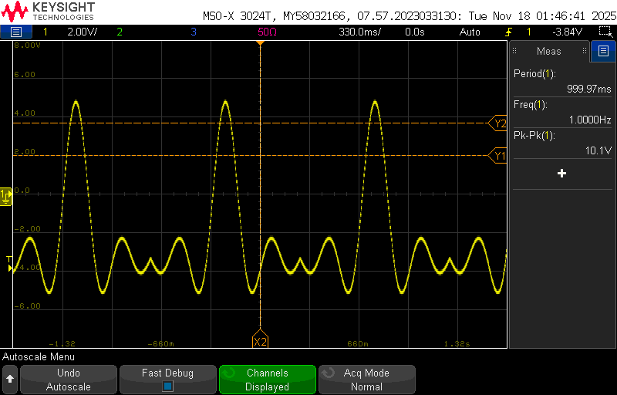
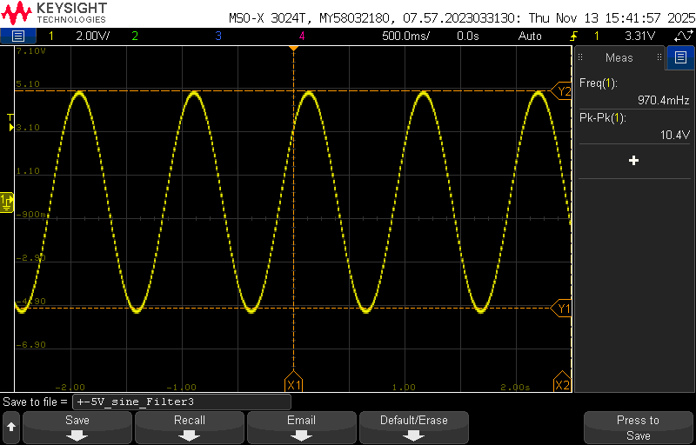
DAC/Output Filter Accomplishments
DC Pulsing:
±5V, 0.5Hz
Sinc Wave:
±5V, 1Hz
Sine Wave:
±5V 1Hz
Notes:
On the upper right is my Analog output filter PCB, which also houses the DACs. Going from the top of the board, we will take in the 16-bit digital code supplied by the FPGA, which will then get passed into the DAC and outputted as current values, which will then pass through the I/V converter, then the 150 kHz low-pass, and lastly the output buffer. The final waveform is outputted through the BNC jack.
As advised by our sponsor Dr. Lusher, we used an Arduino to supply the 16-bit digital code for testing. The testing data can be viewed through these plots, which displays a +-5V DC pulsing wave, a +-5V sinc wave, and a +-5V sine wave. All of these waveforms meet the stated amplitude requirements. Because the arduino has low sampling rate, the waveforms can be slightly stepped at high frequencies and amplitudes. I have confirmed with Dr. Lusher that this is simply an arduino issue, and we will not be getting this issue in 404 when we use the FPGA instead of the arduino to supply the digital codes.

Slide 20
Remaining Tasks
Remaining in 403:
Complete the assembly and testing of the second filter channel
Confirm ±5V, 100 kHz output into 50 Ω for over 15 minutes
To Complete in 404
Fully integrate with FPGA subsystem
Validate correct DAC → analog waveform output from FPGA 16-bit digital codes
Verify multi-frequency waveform generation
Notes:
The second filter system on the board for the AWG’s 2nd channel is identical to the first filter system. Now that I’ve confirmed that the first filter system is working, my remaining task for the filter board is to finish assembling the 2nd filter system and test it to ensure that it is also outputting the correct waveforms.
The next steps in 404 are integrating the board with the FPGA, validating that the DAC converts the 16-bit codes correctly, and confirming the system can generate multi-frequency waveform types cleanly.

Slide 21
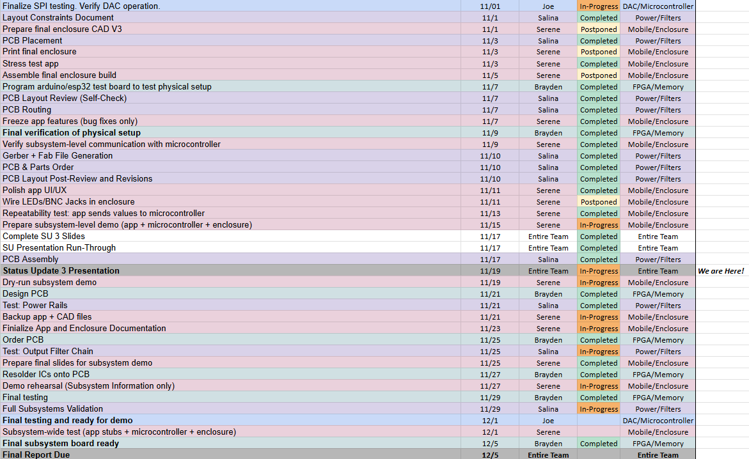
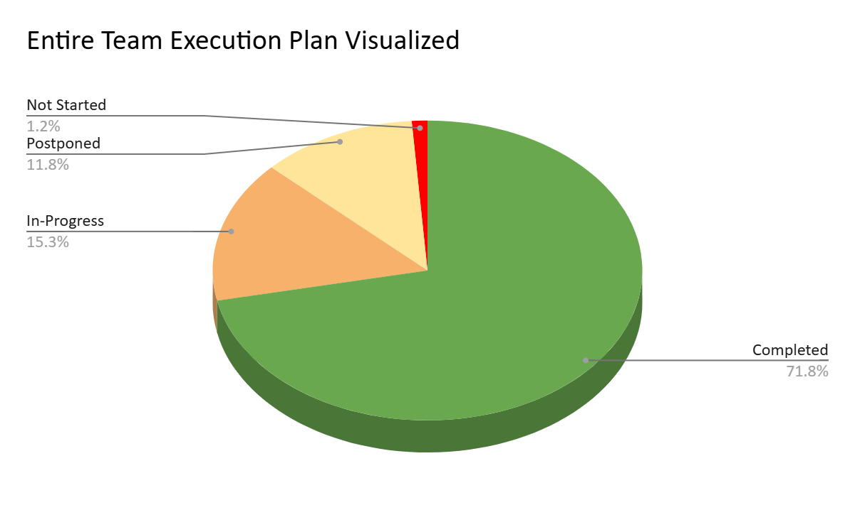
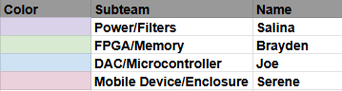
Team Execution Plan Status
Notes:
Execution and validation status against plan (2 slides) showing what has been accomplished. Make sure it is clear for plan which subsystems are associated with each milestone

Slide 22
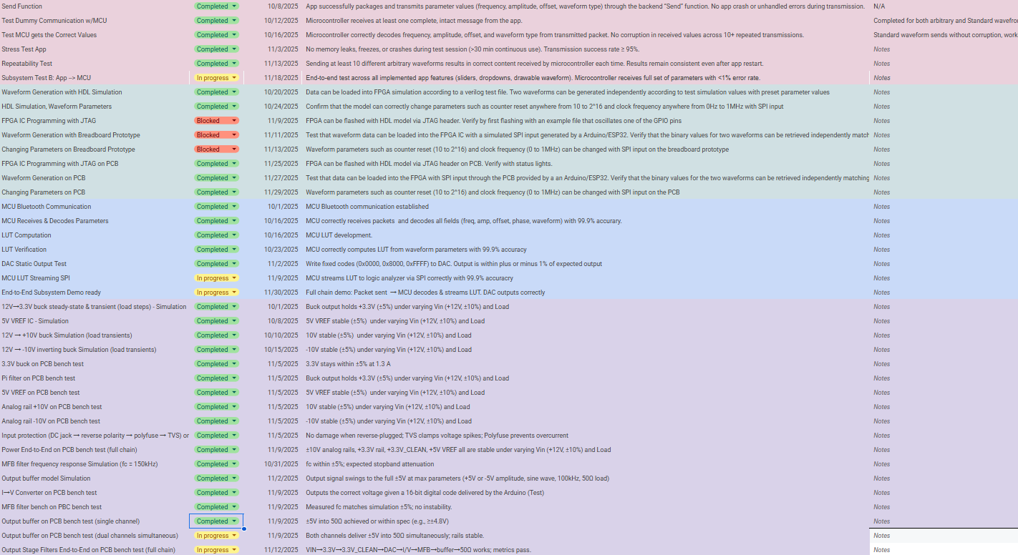
Team Validation Plan Status
Notes:
Execution and validation status against plan (2 slides) showing what has been accomplished. Make sure it is clear for plan which subsystems are associated with each milestone

